Slide 1
Amazon Sales Analysis
Presented by
Sai Krishna Tandasi

Slide 2
Contents
Introduction
Problem Statement
Key Objectives
Tech Stack
Dashboards
Insights
Conclusion

Slide 3
Introduction
Welcome to our Amazon Sales Data Analysis presentation! In this session, we'll delve into the intricacies of our sales performance on Amazon, highlighting key metrics and trends that have shaped our business outcomes. Our goal is to uncover actionable insights that can drive future growth and enhance our market strategy.

Slide 4
Problem Statement
The provided dataset contains information about sales transactions on Amazon, including details such as order ID, date, status, fulfilment method, sales channel, product category, size, quantity, amount, shipping details and more. The objective is to conduct a comprehensive analysis of the data and extract actionable insights to support business decision-making.

Slide 5
Key Objectives
Sales Overview: Understand the overall sales performance, trends, and patterns over time.
Product Analysis: Analyse the distribution of product categories, sizes, and quantities sold to identify popular products.
Fulfilment Analysis: Investigate the fulfilment methods used and their effectiveness in delivering orders.
Customer Segmentation: Segment customers based on their buying behaviour, location, and other relevant factors.
Geographical Analysis: Explore the geographical distribution of sales, focusing on states and cites.
Business Insights: Provide actionable insights and recommendations based on the analysis to optimize sales strategies, improve customer satisfaction, and enhance overall business performance.

Slide 6
Tech Stack
Data Understanding
Understood the data and found Key Performance Indicators (KPIs) of the data
Data Cleaning
Removed unnecessary columns which have no impact in KPIs
Data Analysis
Derived dominant categories in each KPI(Area and Production) with various filters
Uncovering Insights
Created visual Dashboards showing the impact of various sectors influencing the KPIs
Tools Used: Excel, Power Query, Pandas
Derived some key visual insights
Tools Used: Python, Pandas, Seaborn
Tools Used : Microsoft Power BI
KPIs : Amount, Quantity

Slide 7
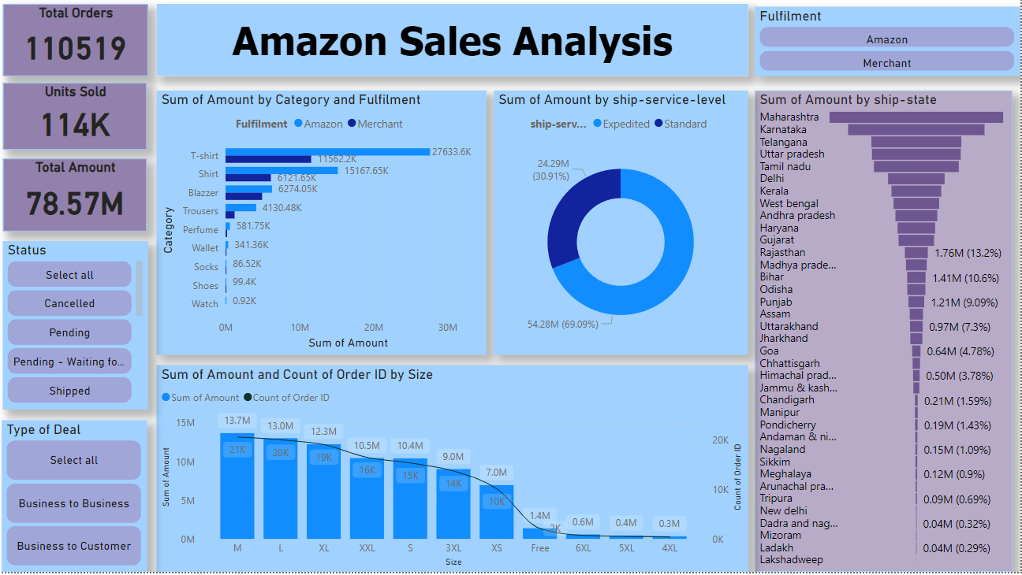
Dashboards

Slide 8
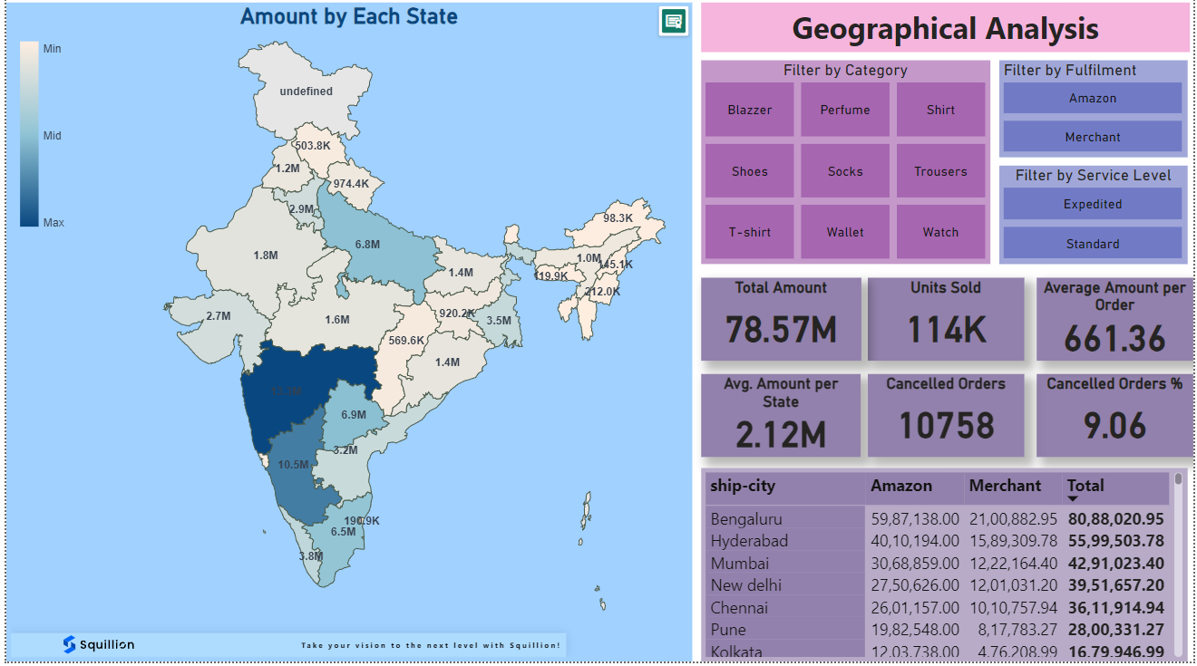
Dashboards

Slide 9
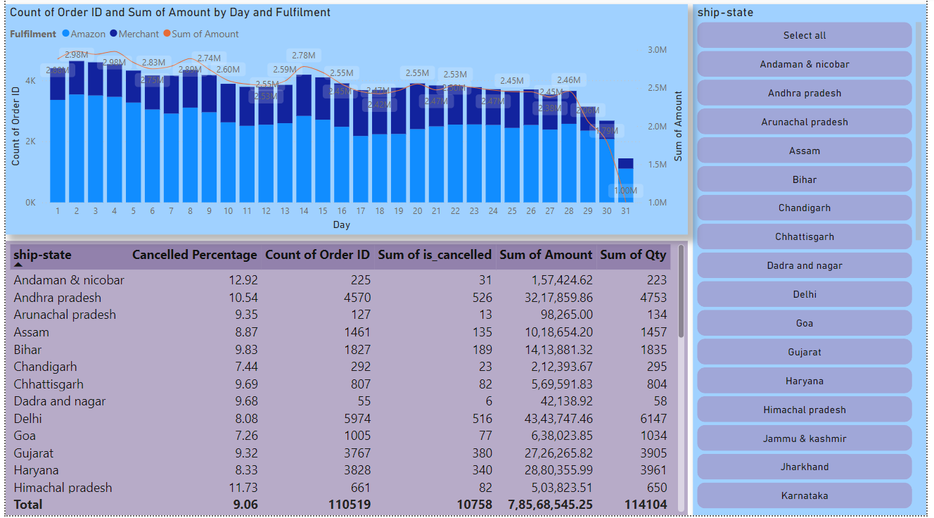
Dashboards

Slide 10
Insights

Slide 11
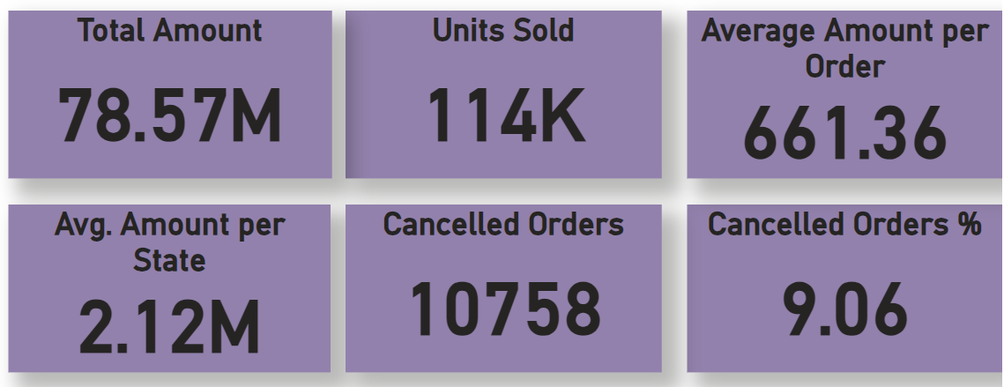
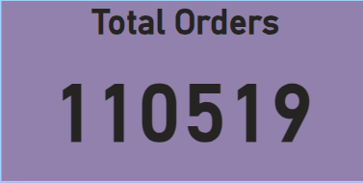
Sales Overview
Around 114K units are sold out with an amount of ₹78.57 Million and through 1,10,519 orders.
Around 11K Orders are cancelled, which is around 9% of whole orders.

Slide 12
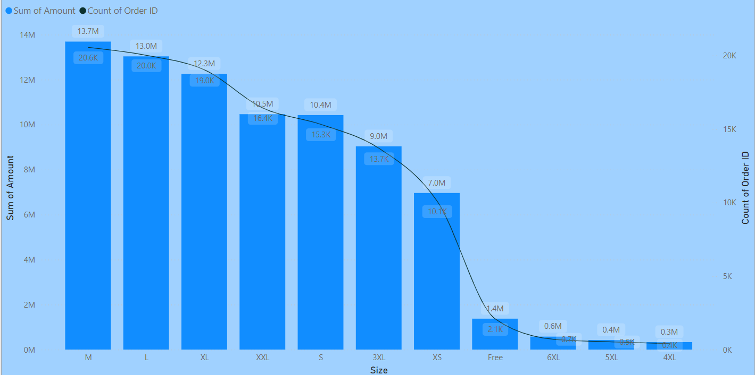
Product Analysis
M,L and XL are the most sold sizes.
Almost 50% of Total Revenue is contributed by M,L and XL Sizes.

Slide 13
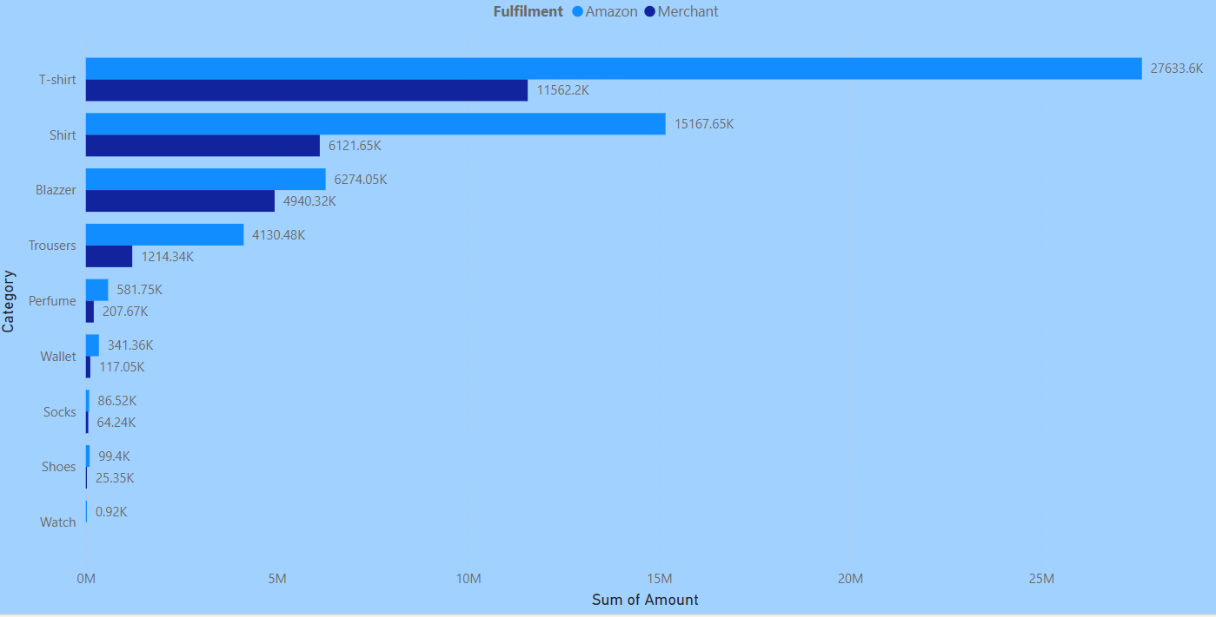
Product Analysis
T- shirts and Shirts are the most sold among all categories with the total amount of ₹39.2M and ₹21.29M respectively.
T-shirts and Shirts are contributing 77% of Total Revenue.

Slide 14
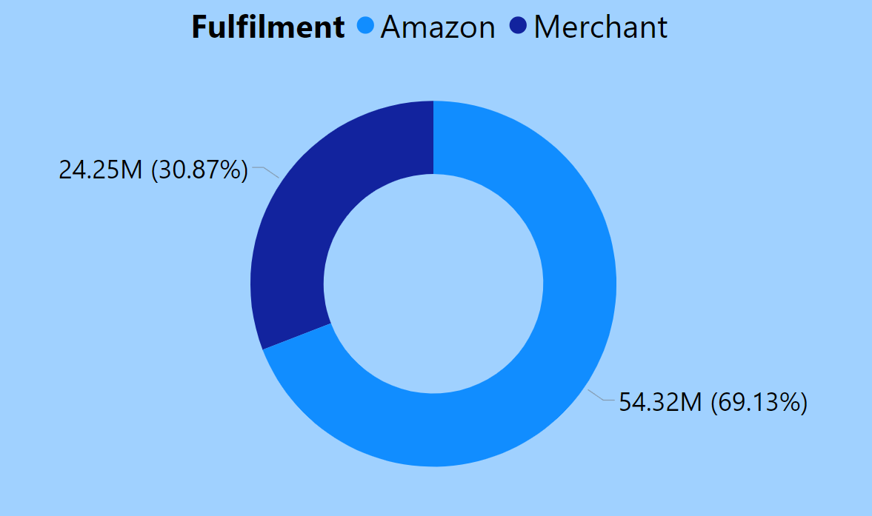
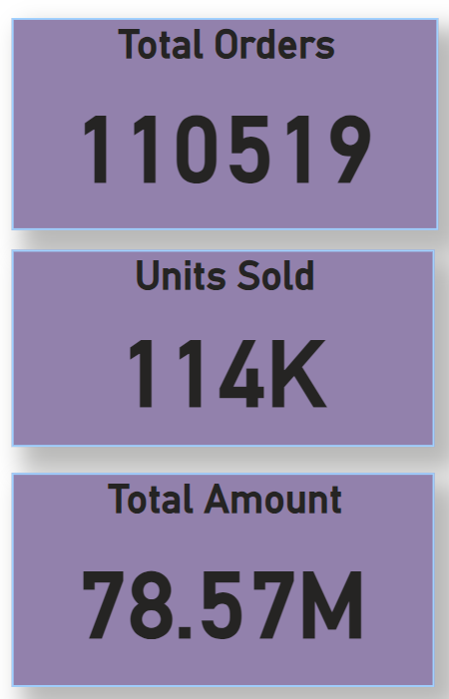
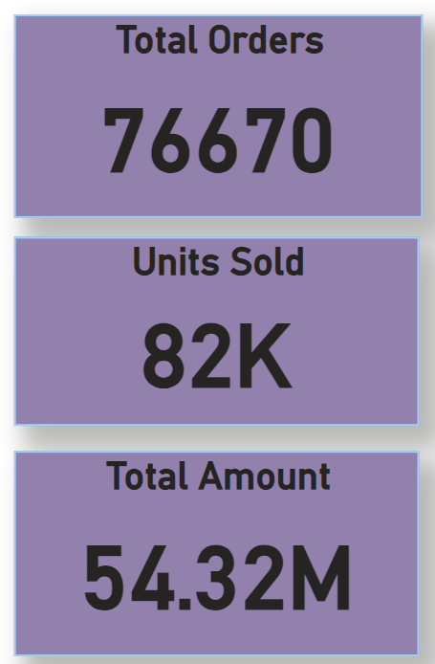
Fulfillment Analysis
Fulfilled by both Amazon and Merchants
Fulfilled by Amazon
76670 orders (69%) are fulfilled by Amazon and rest are fulfilled by their merchants.

Slide 15
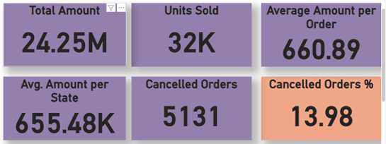
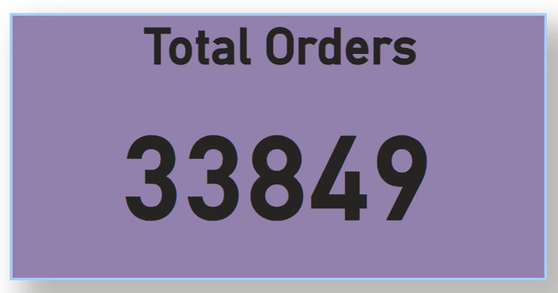
Fulfilment Analysis
Almost 14% of orders are cancelled through the Merchant fulfilment which is significantly high.

Slide 16
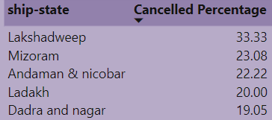
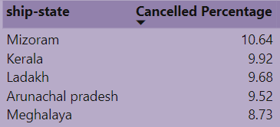
Cancelled orders by Fulfilment methods
Lakshadweep, Mizoram, Andaman & Nicobar, Ladakh and Dadra Nagar are getting more orders cancelled through Merchant Fulfilment.
Mizoram, Kerala, Ladakh, Arunachal Pradesh and Meghalaya are getting more cancelled orders through Amazon Fulfilment.
Hilly Regions and Islands are getting more cancelled orders.
Merchant Fulfilment had more cancelled percentage than Amazon Fulfilment.
Merchant
Amazon

Slide 17
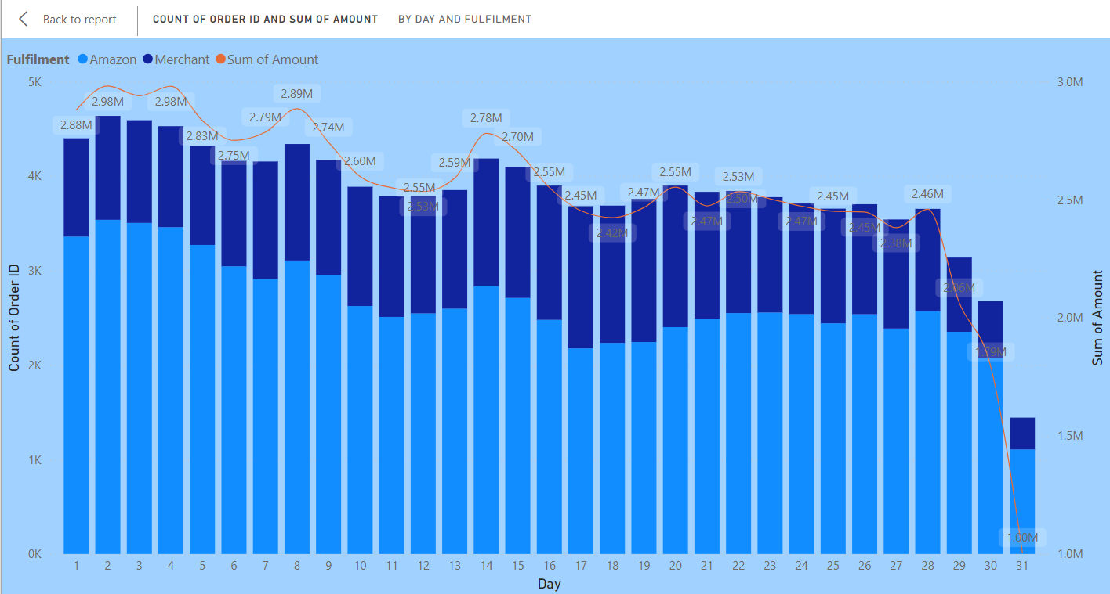
Customer Segmentation
Customers are mostly Preferring the clothes over accessories.
Majority of the accessories are ordered from the Major Cities – Bangalore, Mumbai, Chennai, New Delhi, Hyderabad which is around 90%.
Customers are placing more orders in the first week of every month.

Slide 18
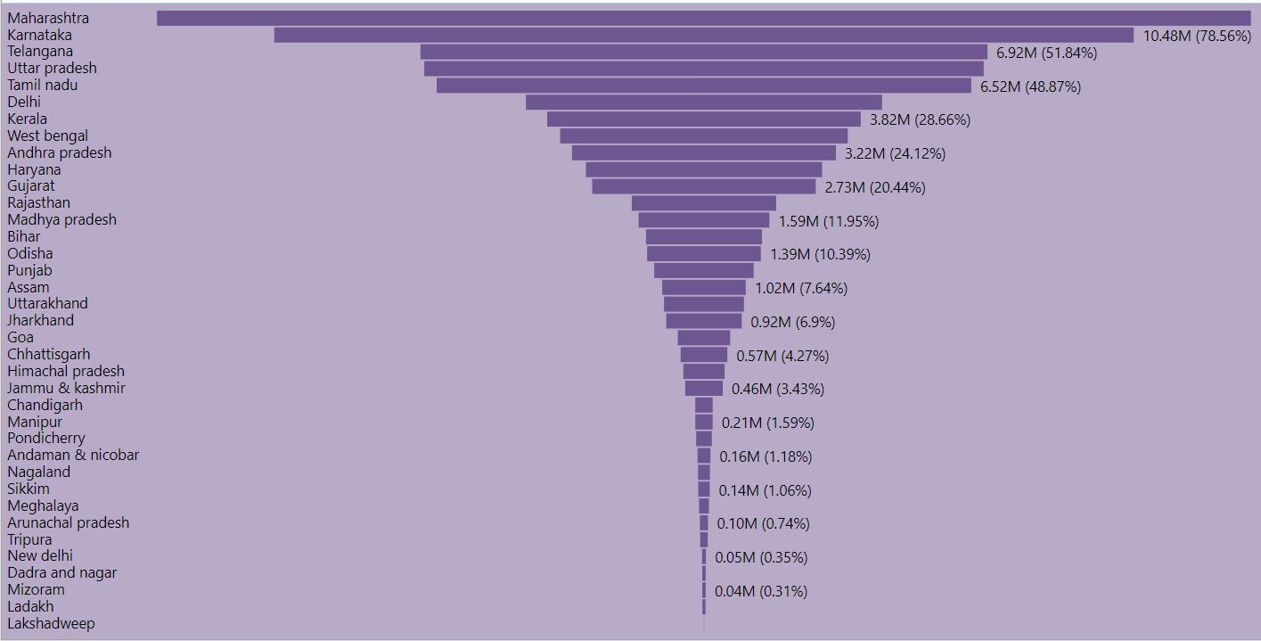
Geographical Analysis
Maharashtra, Karnataka, Telangana, Tamil Nadu and Uttar Pradesh are top 5 states having the most no of orders and Amount.
The above 5 states cover 56% of the total revenue.

Slide 19
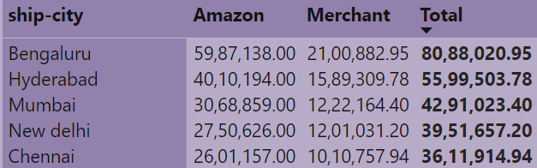
Geographical Analysis
Bengaluru, Hyderabad, Mumbai, New Delhi and Chennai are the top 5 cities having the most no of orders and Amount.
These 5 cities cover 32% of the total revenue.

Slide 20
Business Insights
Customers are mostly ordering the Clothes.
Business is more active in Urban Areas than Rural Areas.
Most no of cancelled orders observed in Hilly regions and Islands.
Fulfillment through Merchant had more no. of shipping issues and cancelled orders.
Customers are mostly ordering in the first week rather than month end.
Accessories had registered less sales which are par below the average.
M, L and XL are mostly selling in size categories.
Urban areas are registering more orders than Rural Areas.
Power BI Link: https://app.powerbi.com/links/2fIelQqwSa?ctid=ce2cf43b-263b-4598-b84d-ed105bc3ebcc&pbi_source=linkShare

Slide 21
Conclusion
Since clothes are ordering mostly, its better to increase the varieties in clothing.
Accessories need to get more stock and offers to increase the sales.
Fulfilment through the merchant need to increase their end user services to decrease the cancelled orders.
Need to redefine the delivery terms and conditions in the hilly areas due to their infrastructure issues, so that we can receive less complaints in shipping issues.
Need to increase the EMI options in all categories, customers are mostly ordering in the starting week of the month.
It is recommended to make sure that all sizes are available before the product is getting into sale, because mostly M, L, XL have more orders.
Rural areas are getting less orders, needed fast delivery and more advertisement.

Slide 22
Thank You

